Slide 1
About Wavecon
1. Wavecon Telecom is a leading provider of mobile network and internet services across India.
2. Recently launched 5G services in major cities, offering:
Faster speeds
Lower latency
Enhanced digital experience compared to 4G
3. Supports 161+ million active subscribers nationwide.
4. Offers a wide portfolio of plans — from affordable entry-level packs to premium high-speed bundles.
5. Provides integrated voice, data, and digital solutions to meet evolving customer needs.
6.This project evaluates Wavecon’s business performance before and after the 5G rollout, focusing on:
Revenue trends
Active user growth and churn
Plan-wise performance

Slide 2
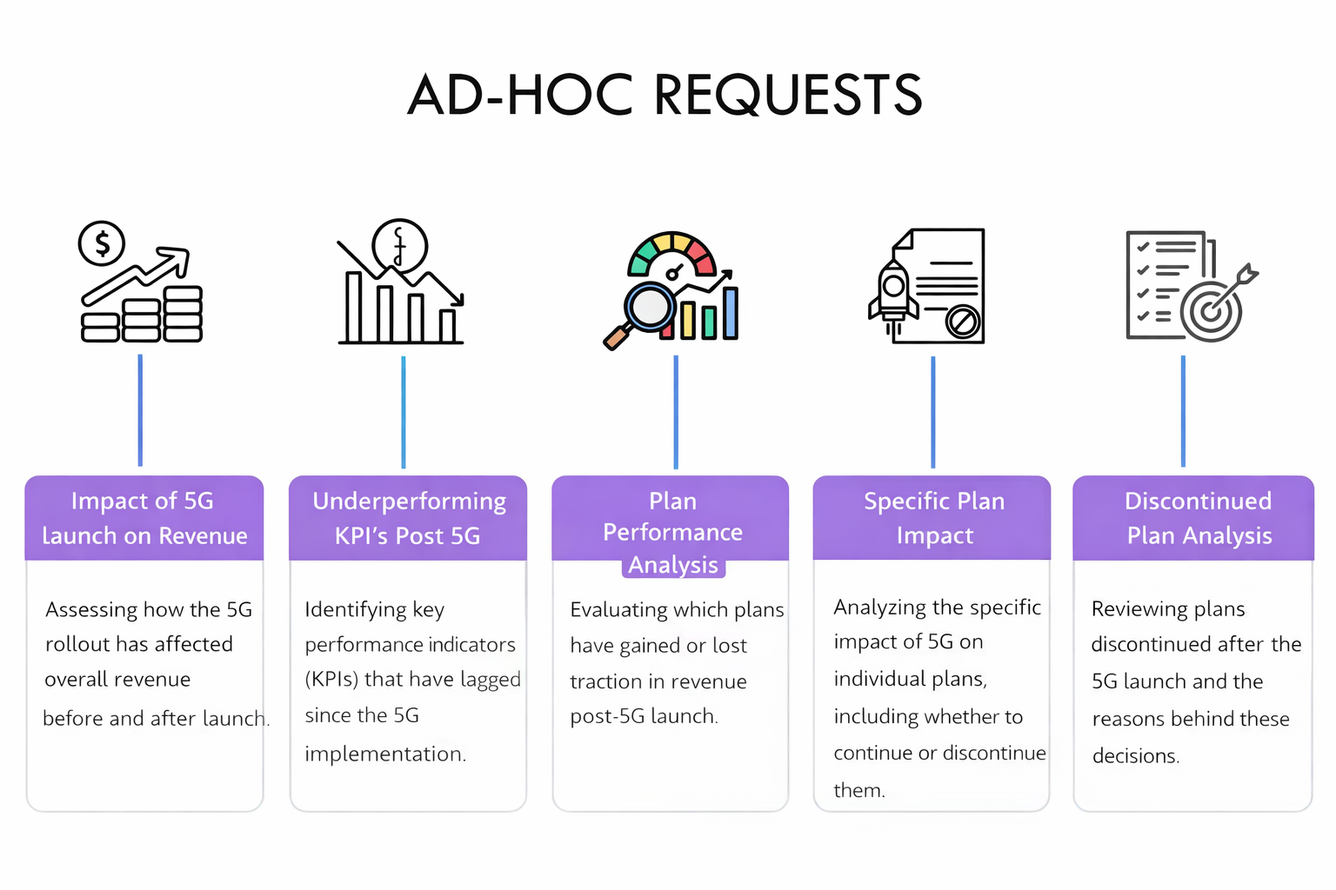
AD-HOC REQUESTS

Slide 3
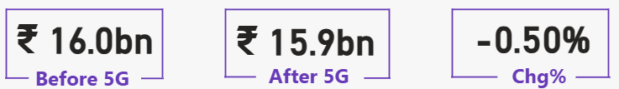
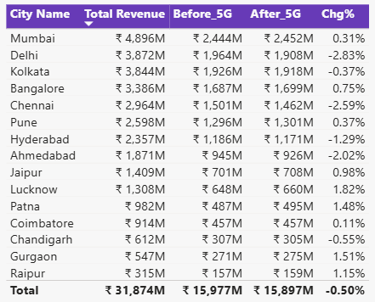
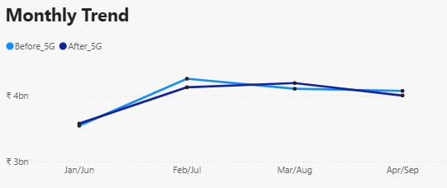
Req 1. What is the impact of the 5G launch on our revenue?
City-Level Performance
Positive Growth Cities: Mumbai, Bangalore, Patna, Pune, Gurgaon
Declining Cities: Delhi, Chennai, Kolkata, Hyderabad
Insight: Metro cities show mixed results; Tier-2 cities like Patna and Jaipur show early adoption momentum.
Insight: Slight dip in total revenue post-launch, indicating neutral short-term impact.
Overall Summary
Wavecon recorded a marginal decline in revenue post-5G.
Metro cities showed mixed performance.
Tier-2 cities posted slight growth, signaling potential for future expansion.
Overall, 5G launch did not immediately boost revenue but shows promise in emerging regions.
Monthly Revenue Comparison
Month Pair | Before 5G | After 5G
Jan / Jun | ₹3.58bn | ₹3.54bn
Feb / Jul | ₹4.26bn | ₹4.13bn
Mar / Aug | ₹4.19bn | ₹4.10bn
Apr / Sep | ₹4.00bn | ₹4.07bn
Insight: Revenue remained stable across months with minor fluctuations.

Slide 4
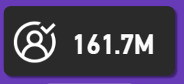
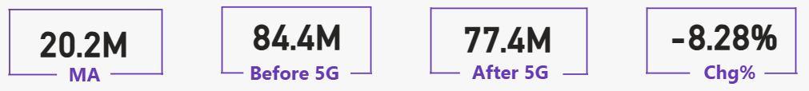

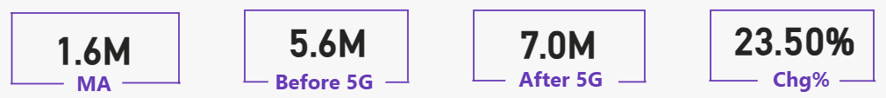
Req 2. Which KPI is underperforming after the 5G launch?
Underperforming KPIs
Active Users dropped significantly, indicating a decline in customer base.
Unsubscribed Users increased, showing higher churn post-5G.
While ARPU improved, it wasn’t enough to offset the loss in subscribers.
Total Active Users
Total unsubscribed Users
Insights
The 5G rollout brought better speed and experience, but customer retention weakened.
Strategic actions are needed to reduce churn and rebuild user engagement.
Focus should shift to customer satisfaction, plan relevance, and targeted retention campaigns.

Slide 5
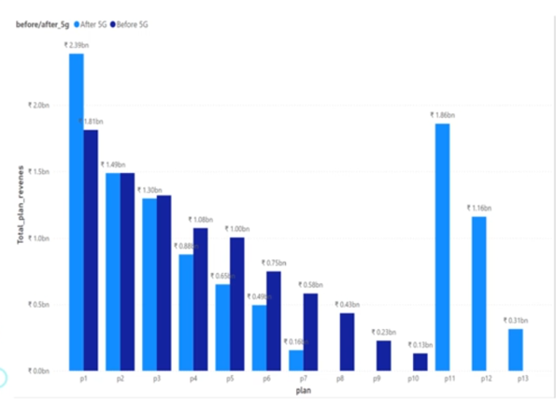
Req 3. Post 5G – Plan Performance Analysis
High-Performing Plans
P1 – Smart Recharge Pack (2 GB/day, 3 months)
Revenue grew from ₹1.81bn → ₹2.39bn (+35%)
Longer duration pack, stable demand, minimal churn.
Newly Launched 5G Packs:
P11 – Ultra Fast Mega Pack (3 GB/day, 80 days): ₹1.9bn, attracting premium users.
P12 – Ultra Duo Data Pack (1.8 GB/day, 55 days): ₹1.2bn, strong adoption.
Insight: Customers are migrating toward premium, long-duration 5G plans.
Mid-Performing / Stable Plans
P2 – Super Saviour Pack (1.5 GB/day, 56 days): ~₹1.5bn, steady revenue.
P3 – Elite Saver Pack (1 GB/day, 28 days): ~₹1.3bn, consistent demand.
Insight: These plans provide a stable base, but no major uplift post-5G
Overall Summary
Winners: Premium, long-duration 5G packs (P1, P11, P12).
Stable: Mid-range packs (P2, P3).
Losers: Short-validity, low-data, and legacy 4G packs (P4–P10).
Recommendation: Continue promoting premium 5G plans, enhance mid-range packs with perks, and phase out obsolete low-data options.
Underperforming Plans
P4 – Mini Data Saver Pack (500 MB/day, 20 days): Declined ~20%.
P5 – ₹99 Full Talktime Combo Pack: Dropped ~34%.
P6 – Xstream Mobile Data Pack (15GB, 28 days | 4G): Fell ~34%.
P7 – 25GB Combo 3G/4G Pack: Sharp decline (~73%).
P8–P10: Short-validity, low-data packs show minimal interest post-5G.
Insight: Small/legacy packs are losing relevance as customers migrate to higher-data 5G options.

Slide 6
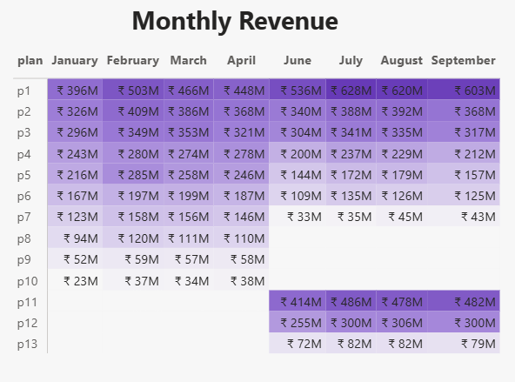
Req 4. Is there any plan affected largely by the 5G launch? Should we continue or discontinue that plan?
Plans Affected Post 5G – Continue or Discontinue?
Comparative Analysis of Subscription Plans
The table compares revenues before and after the 5G launch.
It highlights legacy plans (P1–P10) that were most impacted.
The analysis captures growth trends, stability patterns, and sharp declines.
Plan 7 (25GB Combo 3G/4G Pack) recorded the largest drop (-73%), showing clear customer migration to 5G-enabled packs.
Other short-validity, low-data packs (P4–P6) also declined, though less severely.

Slide 7
Req 5. Is there any plan that is discontinued after the 5G launch? What is the reason for it? 5G LAUNCH IMPACT
Under performing Plan (Revenue Decline)
Recommendation
Discontinue Plan 7 due to sharp decline and poor viability.
Streamline portfolio by phasing out low-data, short-validity legacy packs (P4–P6 also declining).
Focus on premium 5G plans (P1, P11, P12) and consider introducing new 5G bundles with attractive perks to capture demand.
Plan | Plan Name | Before 5G | After 5G | % Change
P4 | Mini Data Saver Pack (500 MB/day, 20 days) | ₹1.1B | ₹876.6M | -20%
P5 | ₹99 Full Talktime Combo Pack | ₹1.0B | ₹651.5M | -34%
P6 | Xstream Mobile Data Pack (15GB, 28 days – 4G) | ₹749.1M | ₹494.6M | -34%
P7 | 25GB Combo 3G/4G Pack | ₹582.4M | ₹155.6M | -73%
Key Insight
Plan 7 is the most severely impacted, with a 73% revenue decline.
Customers migrated rapidly to 5G-enabled, high-data, long-duration packs.
Legacy 3G/4G packs lost relevance in the new market landscape.

